Slide 1
YOUR PRESENTATION TITLE

Slide 2
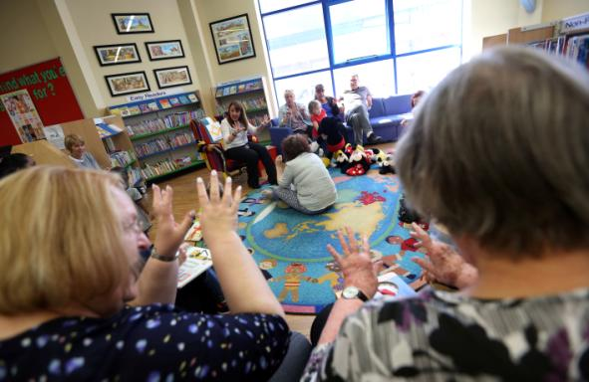
Overview of today’s presentation
What is the Childrens Strategic Partnership?
What does it do?
Delivering together ‘A Better Childhood in Hartlepool’.

Slide 3
A Better Childhood in Hartlepool
Our ambition is for all children and families in Hartlepool to have opportunities to make the most of their life chances and be supported to be safe in their homes and communities.
We can do this if all the agencies that have a role to play work collaboratively to make a difference.
The Children Strategic Partnership is charged with ensuring that this collaboration is done strategically-all the key agencies required to work together to make a difference for children, young people and families have a joint plan and hold each other to account about its delivery.

Slide 4
Three Key Obsessions
Life Chances (Health, Wellbeing, Education and Stability)
Being and Feeling Safe
Relationships and Resilience

Slide 5
Locality Partnerships
Schools and community based agencies and services are key to the successful delivery of the CSP’s ambition. To ensure their engagement the CSP has a devolved Locality Partnership Structure coming into place during 2018/19.
These Locality Partnerships will be led by schools who will enable the participation of local agencies. Their task will be to identify how the obsessions can be delivered locally, prioritise resources to and to ensure effective integrated working.

Slide 6
How will the CSP Deliver its obsessions?
In addition to the Locality Partnerships, there are cross cutting key strategic Groups and activity that will focus on specific ‘transformational’ aspects of the CSPs work and are town wide.
Future in Mind Transformation Group
The Healthy Relationships Partnership
SEND Partnership
Early Help –Operational Delivery Group

Slide 7
How you can be involved
Participate in the activities being delivered by the 4 transformation programmes.
Contact details:
Future In Mind :
Jacqui.Braithwaite@hartlepool.gov.uk
Healthy Relationships Partnership: Jayne.Moules@hrphartlepool.co.uk
SEND:
Early Help:
Danielle.Swainston@hartlepool.gov.uk

Slide 8
Thank you...
For more information about Hartlepool Children’s Strategic
Partnership:
INSERT DETAILS HERE

