Slide 1
Special School for Young People with Social, Emotional and Mental Health (SEMH) Sponsor Engagement Event 20th May 2019

Slide 2
Love Hartlepool

Slide 3
Danielle Swainston Assistant Director, Joint Commissioning

Slide 4
Hartlepool
The vision of Hartlepool Children’s Strategic Partnership is
“To enable all children and families in Hartlepool to have opportunities to make the most of their life chances and be supported to be safe in their homes and communities.”
Working in Hartlepool you get:
A workforce that absolutely want the best for our children and young people in Hartlepool
A committed partnership of schools and partners working together
Will be part of the system – graduated response
Collaborative working
Strong relationship with Parent Carer Forum

Slide 5
Expectations for our children
Adverse Childhood Experiences
Understanding of trauma
Vulnerability
Not necessarily low ability
Expectation that the children accessing the school can access secondary curriculum enabling them to attain GCSEs if appropriate
Ability to work with parents – need for consistent messages

Slide 6
Graduated response
Our bid for an SEMH free school is based on our development of a graduated response that we have been working on with our schools.

Slide 7
Hartlepool Pupils with SEMH Needs – A Graduated Response
A Whole System Approach
Inreach visit to an ARP;
Managed move
Further IPS funding;
Personal [pupil risk assessment and/or
ARP placement
Specialist
Free School
Outreach (which may include);
EP involvement;
CAMHS involvement
Social Care involvement (Family Support, Social Worker, Early Help etc;
OT involvement;
SALT involvement;
Counselling;
SEMH/SENDCo advice (from another school);
ARP advice/support and/or
IPS funding
Additionally Resourced Provision
Co-ordinated Support Plan/additional highly personalised interventions
Internal Interventions
(which may include);
Robust rewards and consequences system consistently applied;
Behaviour Support Plan
SENDCo advice/support;
SLT advice/support
Parental involvement;
SEMH/SENDCo advice (from another school) and/or
ARP telephone advice/support.
SCHOOL TO SCHOOL SUPPORT
Additional school interventions to enable children to work at age related academic, social and behavioural expectations or above
Inclusive quality first teaching for ALL

Slide 8
Free School
Want you to be part of our whole system
Specification indicates 25 places – this is likely to increase following our discussions with DfE due to unit costs

Slide 9
Kelly Armstrong Strategic Commissioner (Children’s and Education)

Slide 10
Hartlepool Local Landscape
2 Special schools
1 Home and Hospital school
1 PRU
35 Mainstream primary and secondary
7 Additionally Resource Bases (ARPS)
5 FE providers (two FE, one sixth form, one school sixth form)
2 Independent Specialists Provisions, 1 11-16 day school, 1 19-24 day school
45 Elective home educated (EHE) pupils
3 Children’s homes (2 LA, 1 Private)
2 Respite Care Provision for young people with SEND (1 LA, 1 Private)

Slide 11
Hartlepool Local Landscape
Statutory School Age Population R – Y11, 13,606
School SEN Support
1958
Total EHC Plans
400
Total number of CLA’s with EHC
36
January Census 2019

Slide 12
Hartlepool Local Landscape
All children (0-16) Hartlepool Local Authority data. These are for plans only Primary need Description % needs for pupils with EHC plans
Row Labels | Count of SEN type
ASD | 27.76%
HI | 1.47%
MLD | 22.36%
MSI | 0.49%
OTH | 2.46%
PD | 3.44%
PMLD | 4.67%
SEMH | 8.11%
SLCN | 13.27%
SLD | 12.78%
SPLD | 2.95%

Slide 13
Hartlepool Local Landscape
All children (0-16) Hartlepool Local Authority data. These are for plans only Secondary need Description % needs for pupils with EHC Plans
Row Labels | Count of SENtype
ASD | 8.79%
HI | 4.95%
MLD | 11.54%
MSI | 1.65%
OTH | 2.20%
PD | 8.79%
PMLD | 0.55%
SEMH | 21.98%
SLCN | 30.22%
SLD | 2.20%
SPLD | 4.40%
VI | 2.75%
Grand Total | 100.00%
SEN support

Slide 14
Hartlepool Local Landscape
All children (0-16) Hartlepool Local Authority data. These are for plans only Primary need Description % needs for pupils identified as SEN Support
Row Labels | Count of SENtype
ASD | 5.19%
HI | 1.71%
MLD | 23.47%
MSI | 0.64%
NSA | 3.04%
OTH | 2.79%
PD | 4.02%
PMLD | 0.10%
SEMH | 16.07%
SLCN | 27.05%
SLD | 0.73%
SPLD | 14.21%
VI | 0.98%
Grand Total | 100.00%
SEN support

Slide 15
Hartlepool Local Landscape
All children (0-16) Hartlepool Local Authority data. These are for plans only Secondary need Description % needs for pupils identified as SEN Support
Row Labels | Count of SENtype
ASD | 6.72%
HI | 1.61%
MLD | 20.43%
MSI | 2.96%
NSA | 2.96%
OTH | 5.91%
PD | 3.49%
SEMH | 17.74%
SLCN | 20.43%
SPLD | 16.13%
VI | 1.61%
Grand Total | 100.00%
SEN support

Slide 16
Hartlepool Local Landscape
Number of placements in specialist provision in Hartlepool;
90 young people in ARPs
80 young people in primary special school
151 young people in secondary and post 16 special school
28 young people in post 19 special school (ISP)
Number of placements in specialist provision in/out of Hartlepool;
31 young people in SEMH Day placements ISP and OOA
7 young people in residential school or children’s homes with specialist school provision for SEMH

Slide 17
Proposed Model and Expectations
25 Day Places
5 Assessment Places
9-18 Years Old
Focus on secondary
Best Value for Money
Children
and Young People
Outstanding Local Area Provision
Preparation for Adulthood
Bespoke packages of education

Slide 18
Hartlepool SEND Funding
Identified inequalities in the way young people with SEND were funded across schools in Hartlepool, began a review and development of new model in 2017.
Developed a needs led approach to funding, moving away from a system of 1:1 funding.
Greater emphasis on accountability and targeting of spend to meet the pupil’s needs

Slide 19
Hartlepool SEND Funding
The SEND Range Descriptors provide a core framework for all professionals working with the pupil and give greater clarity for parents/families/carers in terms of what the needs of their child are and what their child is receiving
The Ranges are from Range 1 through to Ranges 7.
They describe the pupil’s needs and suggestions for the types of interventions that will be required. Schools will need to evidence all their interventions and the impact of these.

Slide 20
Hartlepool SEND Funding
 | Range 1 - School based responses – Universal mainstream
 | Range 2 – School based responses – Universal mainstream
 | Range 3 – School based responses – Universal/Targeted mainstream
 | Range 4i – Targeted Mainstream
 | Range 4ii – Targeted Mainstream / ARP
 | Range 5 – Special School/ARP (Some YP may be in a mainstream setting due to parental choice)
 | Range 6 - Special School Range 7 – Specialist Provision

Slide 21
School Funding
Funding for the Free School ranges from a 6i – 7
Education funding will be made up of two elements:
The per-pupil place element - £10,000 allocated place funding
6i - £14,000
6II - £19,000
7 - £24,000
Assessment places will vary depending on needs of the cohorts and funded at £10k place funding with additional top up.
The top up funding will be agreed by the multi-agency panels, based on individual needs.

Slide 22
Indicative Timeline and Next Steps
20 May 2019 – Hartlepool Free School Consultation, Launch Event
1 July 2019 – Hartlepool Free School Consultation, Second Event
30 September 2019 (midday) Deadline for submitting your application in these competitions
Autumn 2019 - Interviews start
Winter 2019/20 - Approved applications announced
Continue to work with DfE and NSN
Publish further updates on our webpage

Slide 23
SEMH Free School Site
Golden Flatts Hartlepool
Philip Timmins

Slide 24
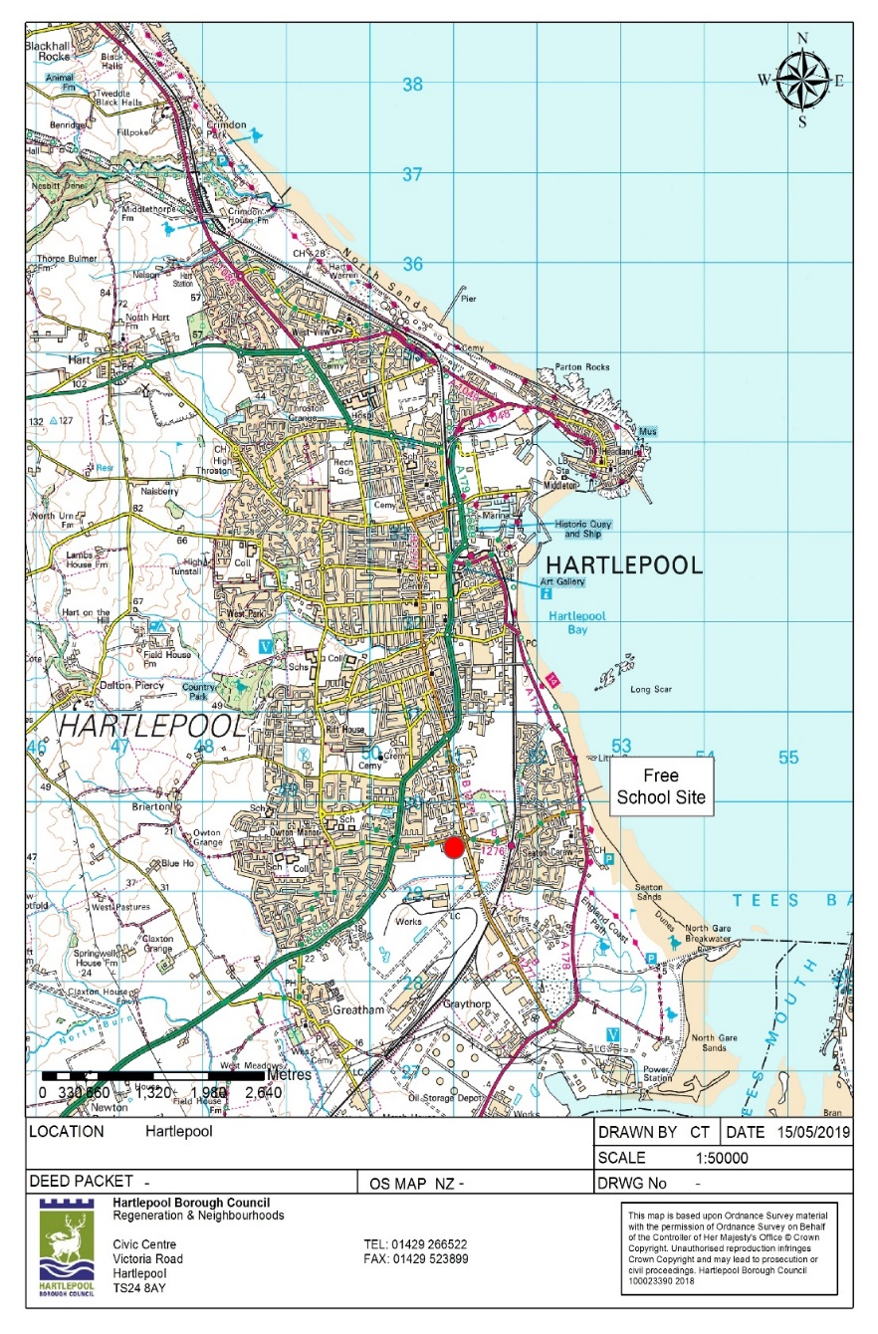
General Location Plan

Slide 25
Surrounding and nearby uses
Golden Flatts Primary School
Whitehorn Gardens supported living accommodation – built 2017
Residential development sites (Council owned at present)
Council owned residential estate – Golden Meadows
Grazing land – Council owned
Development land – potential medical sector and residential
Private Housing
TATA Steel

Slide 26
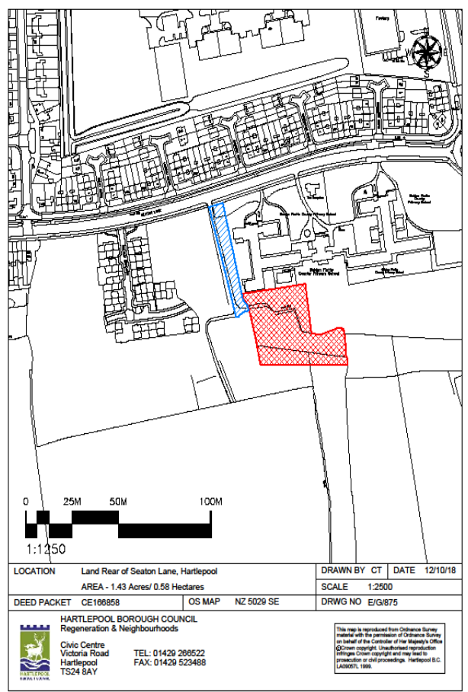

Slide 27
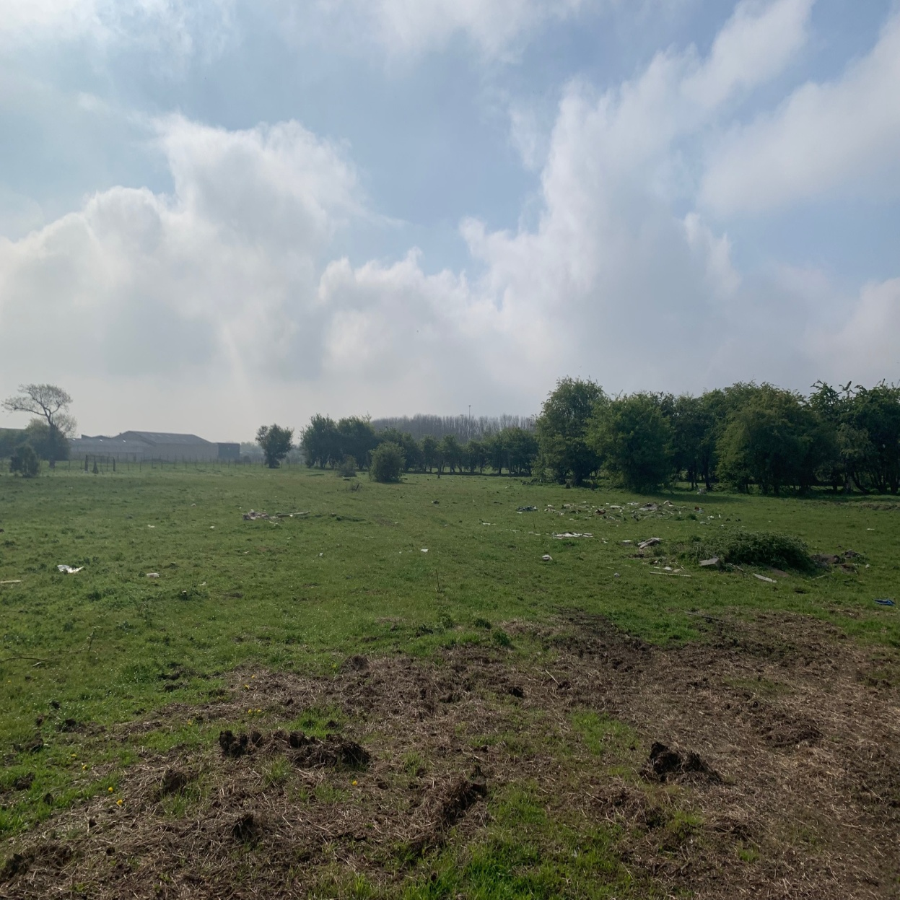

Slide 28
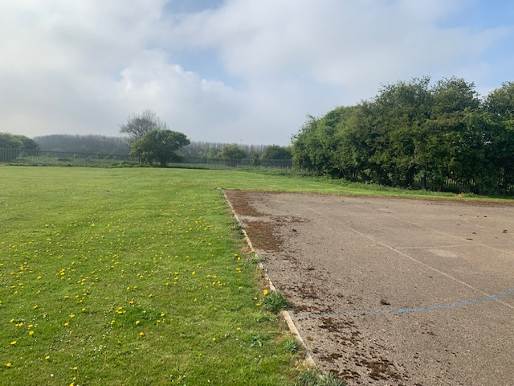
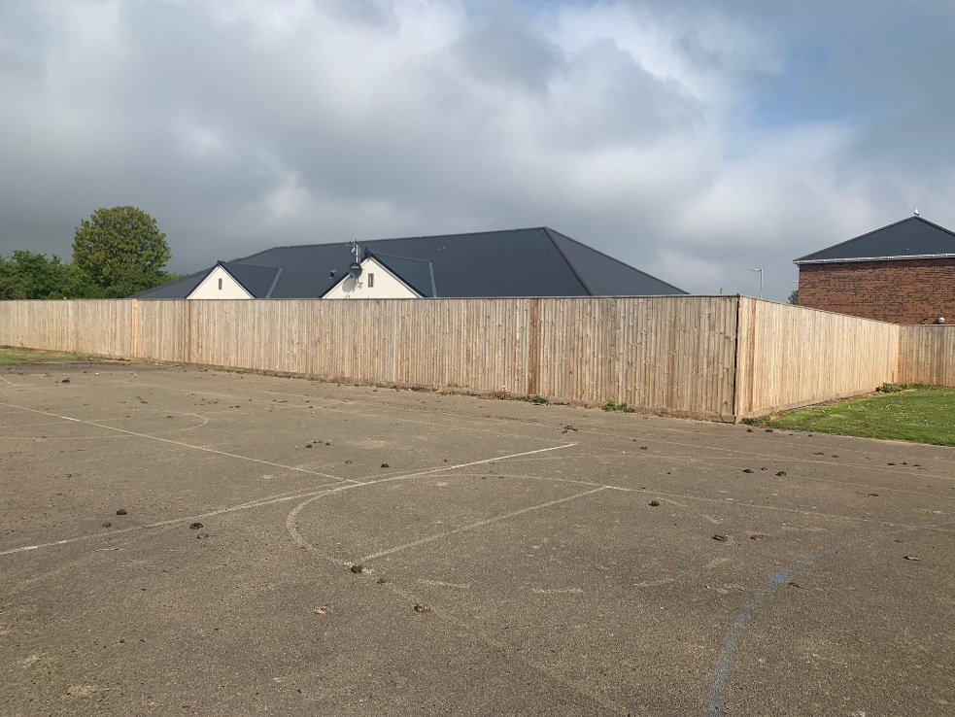
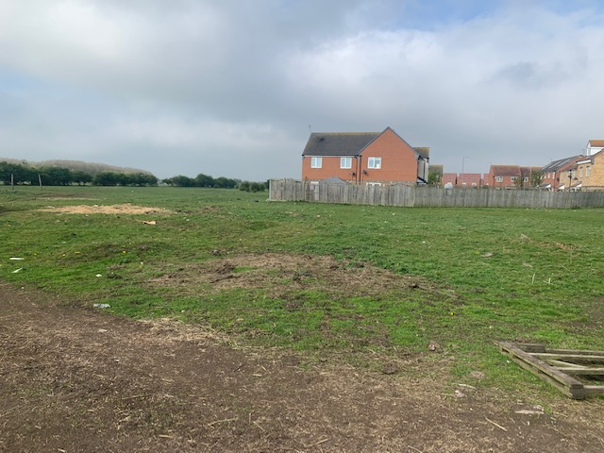

Slide 29
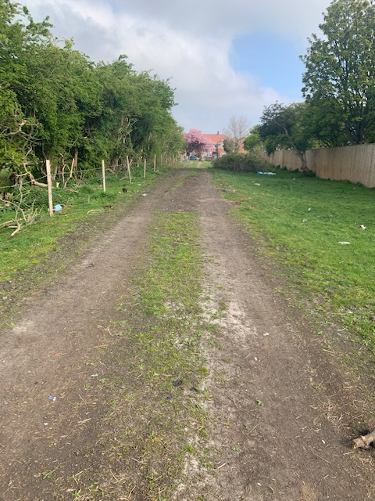

Slide 30
Site Attributes
Fairly level with some hedging and small trees
Present use – grazing
Owned by Hartlepool Borough Council
Planning – Part of “natural and semi-natural green space” but considered suitable for appropriate development
In Flood Zone 1 – very low risk of flooding
Access from Seaton Lane and potentially Brenda Road (to the east)

Slide 31
Questions?

Slide 32
Special school competitions
Notes:
Adviser: Different local authorities will ask for different information to be presented/ different time slots. Edit these slides as you see fit given the brief from the LA and time allocated.

Slide 33
Agenda
Introductions
About New Schools Network
Special free schools: the basics
The special free school application process
How New Schools Network can help you
Questions
Notes:
You must:
Introduce yourself and other NSN team members present
Briefly run through the agenda
Explain that questions will be taken at the end
Explain what is in pack (if appropriate)

Slide 34
About New Schools Network
Independent charity, founded in 2009
Supports free school applicants and open/approved free schools
Worked with around 70% open/approved free schools
Free services
Notes:
You must:
Say we are an independent charity
Mention both campaigning and support work, and how this continues through pre-opening and open stages
Be clear that we will explain in detail at the end of the event about how we can support free school applicants/DP
You could:
Explain that we are part-funded by a DfE grant
Check the room to see how many groups have submitted free school applications in the past/ are aware of the central route process.

Slide 35
Free schools: the basics
What are they?
Who sets them up?
How are the funded?
Freedoms
Notes:
What are they? Mainstream, 16-19, Special, AP. Same legal status as academies.
Who sets them up? Groups of parents, teachers, charities, existing schools, multi-academy trusts etc.
How are they funded? Same per-pupil funding as other schools. Direct from ESFA. Special schools receive base funding and a top-up funding from the commissioning LA.
Freedoms? Free to choose their curriculum. Teachers’ pay and conditions. Governed by an academy trust.
Briefly define each type of free school. AP should be defined as ‘for pupils who are not thriving in a mainstream school, usually for behavioural reasons’.
Talk about some of the freedoms e.g. types of curriculum, governance, budget. You should mention that unlike mainstream free schools, special free schools do need teachers to have QTS. You can give some examples of how some free schools have used this freedom.
Refer to the INSERT LA spec: £10,000 place funding + top-up from the LA. Applicants must demonstrate their proposal will be financially viable within this pupil funding rate. They will be required to specify a pupil funding rate within this band and justify the funding level throughout their bid.

Slide 36
Free schools: the basics
Do…
Do not…
Offer education for pupils aged 4 - 19
Receive more funding than other state schools
Be open to all pupils, regardless of their faith, ability or social background
Get set up by ‘anybody’
Held accountable through Ofsted inspections and exam results
Notes:
You must:
Explain that there are some misconceptions about free schools in the public domain – this is myth-busting
Explain that in their packs they have a table setting out the differences between the types around curriculum, funding, admissions and providing evidence of demand – this is very important information relating to what free schools can and can’t do and we recommend they read it

Slide 37
Special and AP free schools: the basics
There are 34 open special free schools in England
There are 54 that have been approved to open
Only 19 have been inspected by Ofsted: 17 of which are Good or Outstanding
There are 42 open AP free schools in England
There are 11 that have been approved to open
Only 32 have been inspected by Ofsted: 26 of which are Good or Outstanding
Notes:
This is against a national picture of 1,506 other open special schools
89.4% of special free schools are Good/ Outstanding
This is against a national picture of 225 other open PRUs and APs
81.3% of AP free schools are Good/ Outstanding

Slide 38
Special free school application process

Slide 39
Special and AP application process
Bid
The LA
Determines key features
Prepares evidence of need
Identifies potential site
Submits a bid to the DfE
The DfE:
Approves LAs bid documents
Publishes specification and application criteria
Application
Prepare an application with free support from NSN
Submit application to the DfE and LA
Attend an interview with the LA and DfE
Approval from the DfE
Pre-opening phase
Enrol on to NSN Delivery Programme
Recruit staff, develop policies and curriculum, recruit pupils
Support and funding from DfE
Sign funding agreement
Open phase
Continue relationship with NSN
Build up to capacity
Ofsted inspection with three years
Notes:
You must:
Explain DfE = Department for Education
Explain that Pre-Opening = period between approval of application and opening of school
Explain this is a new wave. This is the only 2nd time the free school process has been run in this way. Last wave was autumn 2017 with 14 special schools being approved in March 2018, creating 1100 new places for students. NSN worked with 11 of the 14 successful sponsors.
This wave has 37 special free school specs and 2 AP creating around 3500 new pupil places.
Talk through the process.
Explain differences between the mainstream process and bid process.
Highlight involvement of both DfE and LA throughout.
Explain pre-open and open is fairly similar to mainstream.
Explain LA will be more involved than mainstream schools in pre-open & open as the commissioner for special places and some AP places.
Be clear that capital and pre-open funding is still provided centrally from DfE.
Discuss site in bid & affect on pre-opening.
You do not need to:
Explain in detail the services NSN provides (this will be done later)
15th October 2018 - Deadline for LAs to submit bids
30th September 2019 – deadline to submit your application.

Slide 40
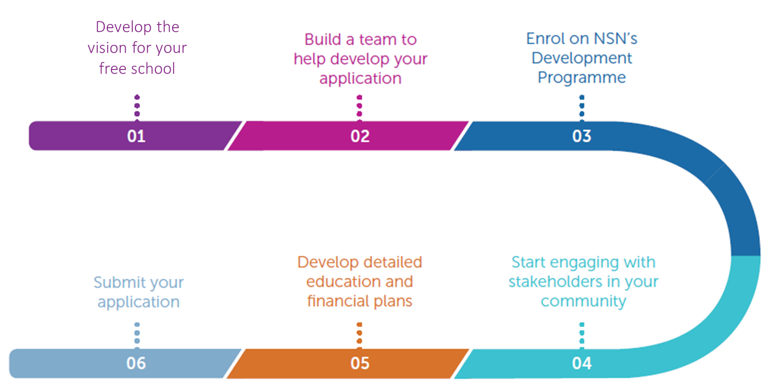
Application timeline
Pre-opening phase
Recruit staff, develop policies and curriculum, recruit pupils
Secure a site
Enrol onto NSN Pre-opening Programme
Support ad funding from DfE
Sign funding agreement
Notes:
You must:
Explain that this timeline is indicative: applicants will need to be working on several different areas at any one time
Discuss some of the key issues involved in each step of the application process.
Engaging with stakeholders in your community includes those commissioning places at your proposed school, local partners and providers, local parents/carers forums and students/young people.
Explain that we will provide more information about how to enrol on the Development Programme later on

Slide 41
Lessons learnt
Notes:
You must:
Explain that our experience of working with hundreds of groups informs our approach to advice and support for applicants.
The next few slides will cover key aspects of the application applicants should start thinking about (vision and the team).

Slide 42
Developing a vision
A clear vision will act as the basis for all other activities related to your free school:
Vision
Building a team
Application development
Engaging the community
Notes:
You must:
Explain what a vision is:
The vision should underpin the rest of your application. It provides the basis for all other decisions, including the way you organise your curriculum and your pupils, the range of staffing, how you allocate the budget and the premises in which the school will operate. A clear vision is the foundation of a strong application – it should convince the LA, the DfE and the parents of prospective pupils of the value of your proposed school.
Explain the importance of having a clear vision for the school for:
Your team - all the members of your group must be committed to a shared vision
The application – the vision is its own section and everything in the application should build on what is mentioned here
Showing demand and engaging the community – you must present a clear, consistent vision for your school

Slide 43
Presenting your vision
The DfE states that all applicants must:
explain your own vision for the proposed school, and how it will deliver the local authority’s specification;
explain how that vision comes across in your curriculum approach and approaches to meeting pupils’ special educational needs; and
ensure that your vision is evidence-based and consistent with the rest of your application – your overall application should clearly show the plan for implementing your vision.
Notes:
You must:
Explain what a vision is:
The vision should underpin the rest of your application. It provides the basis for all other decisions, including the way you organise your curriculum and your pupils, the range of staffing, how you allocate the budget and the premises in which the school will operate. A clear vision is the foundation of a strong application – it should convince the LA, the DfE and the parents of prospective pupils of the value of your proposed school.
Explain the importance of having a clear vision for the school for:
Your team - all the members of your group must be committed to a shared vision
The application – the vision is its own section and everything in the application should build on what is mentioned here
Showing demand and engaging the community – you must present a clear, consistent vision for your school
Explain the criteria on the slide is not all the criteria for section C but is to help start the building blocks of a vision.

Slide 44
The vision
Developing a clear vision involves thinking about these key elements:
Hartlepool specification
School ethos and key features
Outcomes
Notes:
You must:
Explain that our experience tells us that a good vision is created through consideration of these elements. Whilst they don’t need to discuss outcomes in the Vision section of the application, they should certainly think about these to hep them determine the key features of their school
Discuss each element (press mouse for each box to appear in turn):
LA & the specification – you must understand your area and its needs. Your application must meet with the requirements of the INSERT LA specification, and consider how the new school will fit into the education landscape.
Outcomes – you must then work out what you want outcomes for the school and its pupils to be. Explain what groups can consider for their outcomes: the academic performance of pupils, the performance of the school as a whole, non-academic skills and attributes pupils will develop, the school’s impact on the local community
Ethos/core features – you must then, and only then, work out how these will get pupils from where they are now to where you want them to be. Provide examples of a school ethos and key features, e.g. core values of the school, the curriculum you would like to use, non-academic activities pupils will engage in.
Explain that applications which do not consider their area’s needs, or impose ideas about schools onto them tend to be weaker
Add that any groups who are already an education provider will also need to discuss the overarching vision of their trust and how the new school fits into the vision, etc.

Slide 45
Importance of a strong team
Applying for, setting up and opening a free school is an extremely demanding process. It’s essential that you have a strong, committed team with a wide range of skills working on the project.
Some of the challenges your team will face include:
Engaging with stakeholders and commissioners
Building a financial plan for the school
Designing a curriculum
Managing the project as a whole
Notes:
“Applying for, setting up and opening a free school is an extremely demanding process. It’s essential that you have a strong, committed team with a wide range of skills working on the project.”
You must:
Explain why it is important to have a strong team – because the free school will only be as good as the people setting it up, and we know from experience that the DfE will not approve proposals where they have doubts about the team.
Stress the importance of each member of the team sharing the same vision
You could:
Illustrate the demands that are placed on teams through your own experiences of working with groups
Ask attendees to tell you the skills they think are needed for setting up a free school

Slide 46
Establishing your curriculum and ethos
You must have the following:
Education expertise relevant to the type of school you want to set up
Finance expertise
Governance expertise
You should have the following:
Project management expertise
Marketing/communications expertise
Necessary for pre-opening:
HR expertise
ICT expertise
Buildings and sites
Legal expertise
Business/start up experience
Additional advisers
Steering group
Lead proposer
Notes:
You should make it clear to applicants that without robust education expertise (which in practice means having on board a deputy or a head teacher with a strong track record in a “good” or “outstanding” school of the relevant type and age range) the group will not be approved by DfE. It is important the education lead has a good understanding of the special educational needs/ needs of the expected pupil cohort. In addition, groups must have finance expertise (ideally a school business manager, but accountancy or business management will do) and governance expertise. You should explain why these things are essential at application stage.
You should also explain that different skills and expertise are needed in the pre-opening and application stages, as outlined above, and the skills required for the application are more important at this stage. Groups should aim to recruit the necessary expertise to their team prior to application submission, or list the area as a skills gap and outline how they will fill this in the application.
Explain that different members of the team will have different levels of involvement – lead proposer several days a week, steering group weekly or more and advisers more ad hoc. Explain importance of matching your expectations of involvement with other members of the team, and this means that the composition of your team might shift and change. In particular, your education and project leads must be part of the core group and be able to offer robust time commitments in application and pre-opening.

Slide 47
How New Schools Network can help you

Slide 48
NSN Development Programme
Feedback we have had from groups who have been on the programme has been overwhelmingly positive, and approval rates for groups on the programme shows its success.
“The Development Programme was excellent and offered appropriate support, challenges and rigour.”
100% of those who have received this additional support in the past said it was helpful
You are 50% more likely to be invited to interview.
“We couldn’t have done it without you! Thank you so much for keeping us on track and motivated.”
11 of the 14 successful free schools from the local authority-led special free school round wave 1 received NSN support.
Notes:
DP interview and approval rates are significantly higher than overall approval rates, which are roughly 50%
11 of 14 wave 1 special round were on DP .

Slide 49
How NSN can help you
Development Programme
A combination of the following:
A named personal NSN Adviser
A personalised support plan
Written feedback on draft applications
Specialist meetings
Networking with other free schools
Help marketing your school
Support for all groups
An hour long 1-1 meeting with one of our Advisers
Advice from the team via phone and email
A wide range of resources on our website.
Notes:
YOU MUST:
Explain that NSN is here to help everyone but that we have two levels of service. This is so that we can target the most intensive support for those who will benefit from it most, and we would strongly advise enrolling on the DP so that they can access this support
Expand on the DP support using the slide and your knowledge. Stress that this is a bespoke service – applicants will receive a combination of the services listed below that we will tailor according to their needs. More experienced groups may not need all of the available support, whilst groups with no experience of running a school are likely to need more support.
On marketing funding, say ‘Financial support may be available in some circumstances to help with travel or marketing costs.’
State that getting on the DP is not a guarantee of ultimate success and not getting on is not a mark against your application to the DfE

Slide 50
Enrolling onto the DP
Book a 1-1 meeting with an adviser through our website.
Submit an enrolment form through our website
Contact NSN
Email: info@newschoolsnetwork.org
Phone: 020 7952 8558
Website: https://www.newschoolsnetwork.org/
Notes:
YOU MUST:
Explain that NSN is here to help everyone but that we have two levels of service. This is so that we can target the most intensive support for those who will benefit from it most, and we would strongly advise enrolling on the DP so that they can access this support
Suggest booking a 1-1 meeting with advisers as soon as possible to discuss the free school process and their proposal.

Slide 51
Questions?

