Slide 1
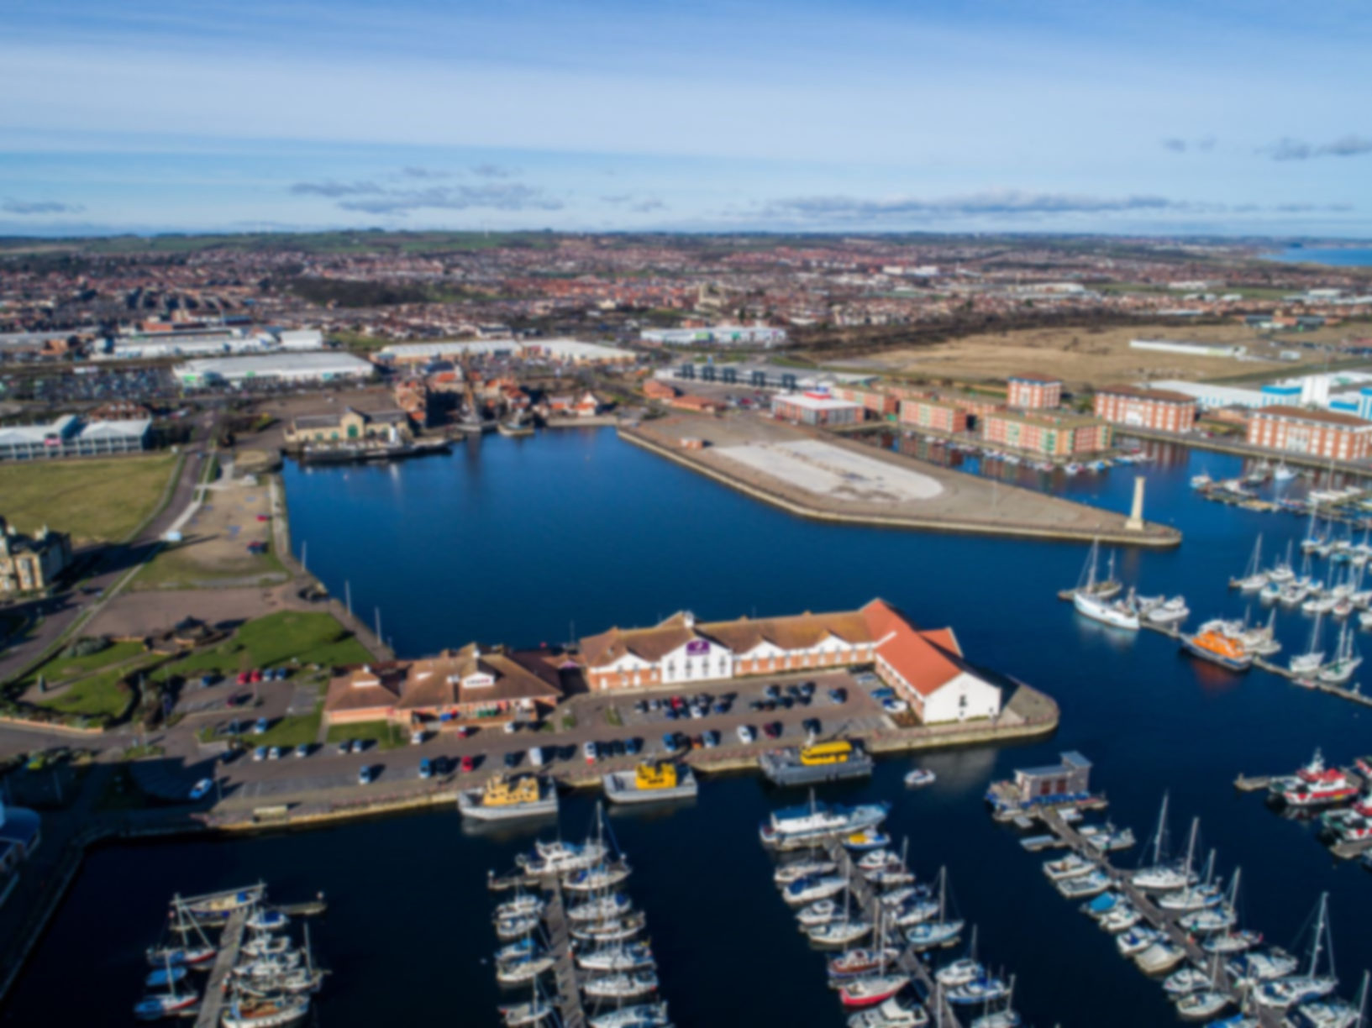
HARTLEPOOL TOWN DEAL BOARD PROGRAMME REPORT
July 2021

Slide 2
Project Updates
Jacobs commissioned
Communications and Engagement Sub Group met
Business Case readiness of all projects reviewed
Engagement Platform launched
RAG (Red/Amber/Green rating system)
Ratings are provided to help quickly identify what is on track and what is at risk. Considerations for these could include time, quality, cost and stakeholder engagement.
At significant risk of failure to deliver, requiring immediate attention and corrective action to be taken
Serious risk(s) which could have a major impact on the project and which need to be managed closely
Potential risk(s) exist which could have an impact on the project and need to be managed
Low level or emerging risk(s) which could impact the project but which can be managed
Minor risk(s) unlikely to have impact on the project

Slide 3
PROJECT UPDATES
BUSINESS CASE | COMPLETION DATE (including full independent assurance and approval) | PROGRESS UPDATE | KEY RISKS | OUTCOMES MANAGEMENT
Reimagining Middleton Grange | TBC at the next Towns Deal Board following current evidence base review | Review of evidence base and identification of next steps currently underway | Cost increases following detailed design and survey work Failure to acquire buildings- potential impact on programme timescales and costs Survey works reveal structural or other issues Lack of operational plan for public space and end user for building | RAG rating of whether project can deliver planned outcomes
Wesley Chapel Hotel Redevelopment | TBC at the next Towns Deal Board following current evidence base review | Review of evidence base and identification of next steps currently underway | Market demand does not materialise as predicted Cost increases following detailed design and survey work
Waterfront Circuit Phase 1 | TBC at the next Towns Deal Board following current evidence base review | Review of evidence base and identification of next steps currently underway | Potential for complementary schemes not to be delivered, resulting in an isolated, unintegrated area of enhanced urban realm High level nature of current cost estimate Cost increases following detailed design and survey work
Civil Engineering Institute | TBC at the next Towns Deal Board following current evidence base review | Review of evidence base and identification of next steps currently underway | Cost increases following detailed design and survey work. Potential for learners to migrate out of Hartlepool once skills are obtained.
Health and Care Academy | TBC at the next Towns Deal Board following current evidence base review | Review of evidence base and identification of next steps currently underway | Cost increases following detailed design and survey work Potential for learners to migrate out of Hartlepool once skills are obtained.

Slide 4
PROGRAMME OVERVIEW Template
KEY |  | Independent assurance/approval
 |  | Business case complete
 |  | Summary documents submitted
Project | RAG |  | July-Sept |  |  | Oct-Dec |  |  | Jan-March |  |  | April-June
Reimagining Middleton Grange | Last month N/A | This month | Evidence base review | Identify next steps
Wesley Chapel Hotel Redevelopment |  |  | Evidence base review | Identify next steps
Waterfront Circuit Phase 1 |  |  | Evidence base review | Identify next steps
Civil Engineering Institute |  |  | Evidence base review | Identify next steps
Health and Care Academy |  |  | Evidence base review | Identify next steps
Summary documents to MHCLG
Engagement Plan
Monitoring outcomes
Top programme risks | RAG | Mitigations
Lack of definition of business case programme |  | Identification of next steps and detailed delivery plan to be undertaken imminently
Lack of capacity to develop business cases within the timescales |  | Identification and securing additional capacity
Milestones
Achieved since last Board | Upcoming milestones
Business Case review commenced | Detailed plan in place for delivery of business cases- August 2021 Submission of Annex A- July 2021 Launch of Engagement Platform- August 2021
Budget
Actual spend | Budget | Forecast outturn
£0 | £25,000,000 | £25,000,000
Overall programme rating

Slide 5
DECISIONS FOR THE BOARD
The Board is asked to make a decision on the following:
Consider the recommendations of the Communication and Engagement Sub Group and employ an engagement practitioner from the remaining Capacity Funding.

