Slide 1
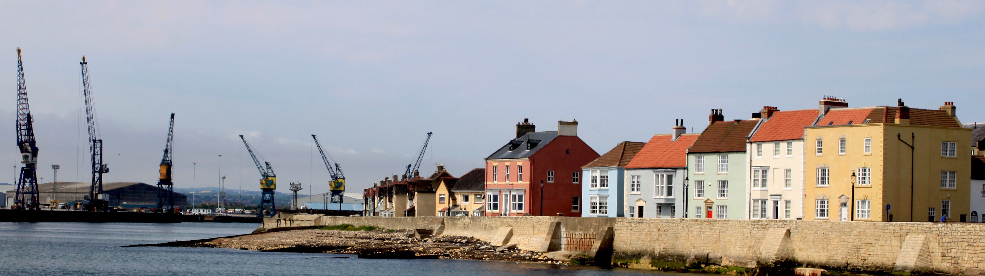


Pride in Place Update
Health and Well Being Board
Monday 16th February 2026

Slide 2
Introduction
The Pride in Place programme is a major community regeneration and empowerment initiative led by the UK Government, and provides the following investment for Hartlepool:
Pride in Place Programme:
Hartlepool will receive £20m of funding over the next decade (£2m a year) from April 2026 with 75% Capital Funding and 25% Revenue Funding
Impact Fund:
Hartlepool will receive £1.5m of capital funding for immediate improvements with £750k already received for 2025/26 and £750k in 2026/27
Pride in Place is overseen by the Hartlepool Board which includes representation from the business community and is a Local Strategic Partnership.

Slide 3
Pride in Place Strategic Objectives
1
2
3
Stronger Communities
All places should have strong relationships and a collective sense of belonging to their community. This helps bring people together to build community cohesion and resilience, helping people to feel proud of their area and safe in their Neighbourhood.
Thriving Places
Every part of the UK deserves to have vibrant neighbourhoods and communities with busy high streets, a good range of local amenities and high-quality physical infrastructure.
Empower People
Everybody should be empowered and in control of their lives and have a say over the future of their community.

Slide 4
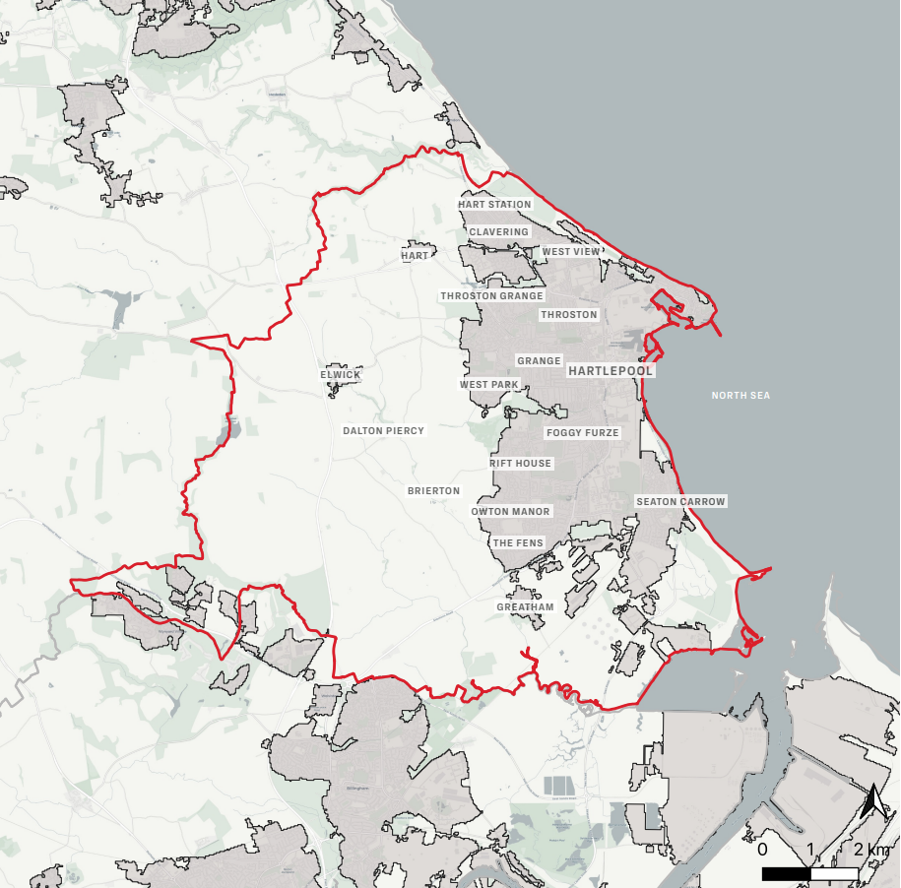
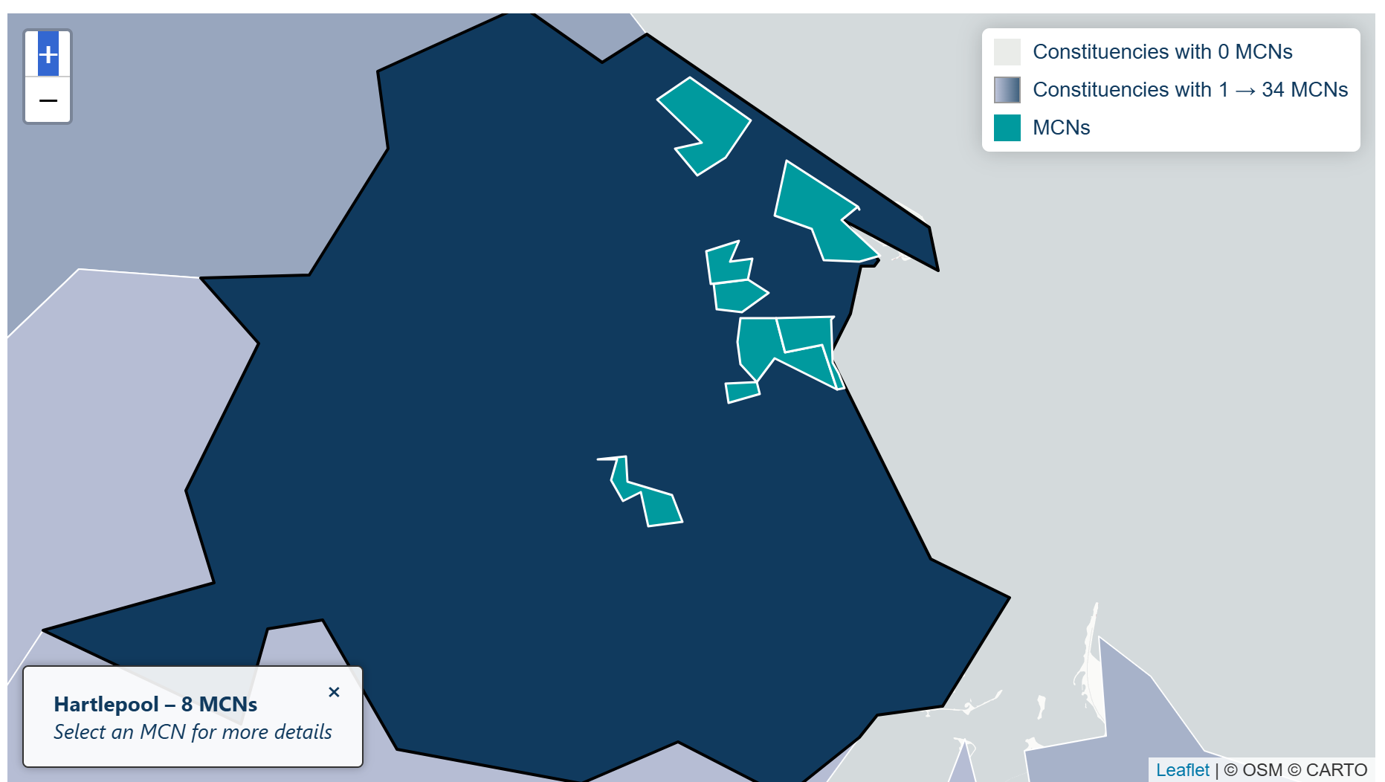
Boundary Line

Slide 5
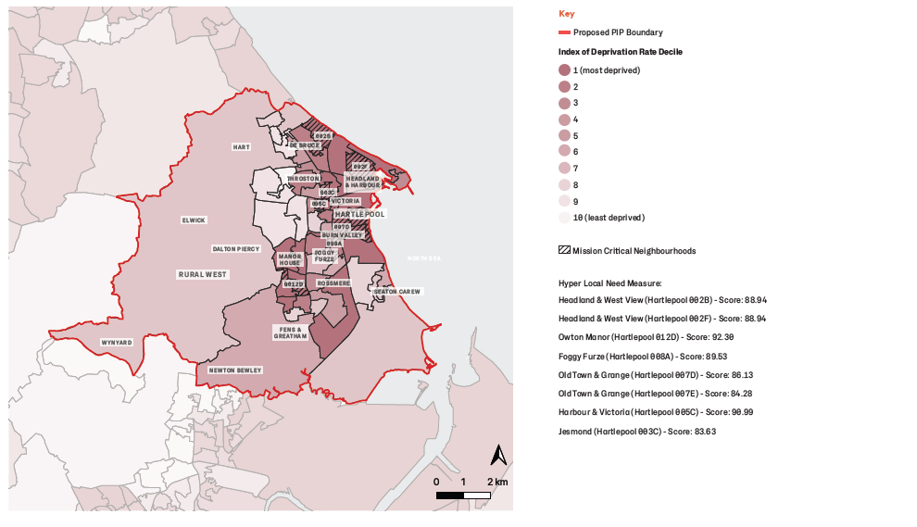
Indices of Deprivation & Mission Critical Neighbourhoods

Slide 6
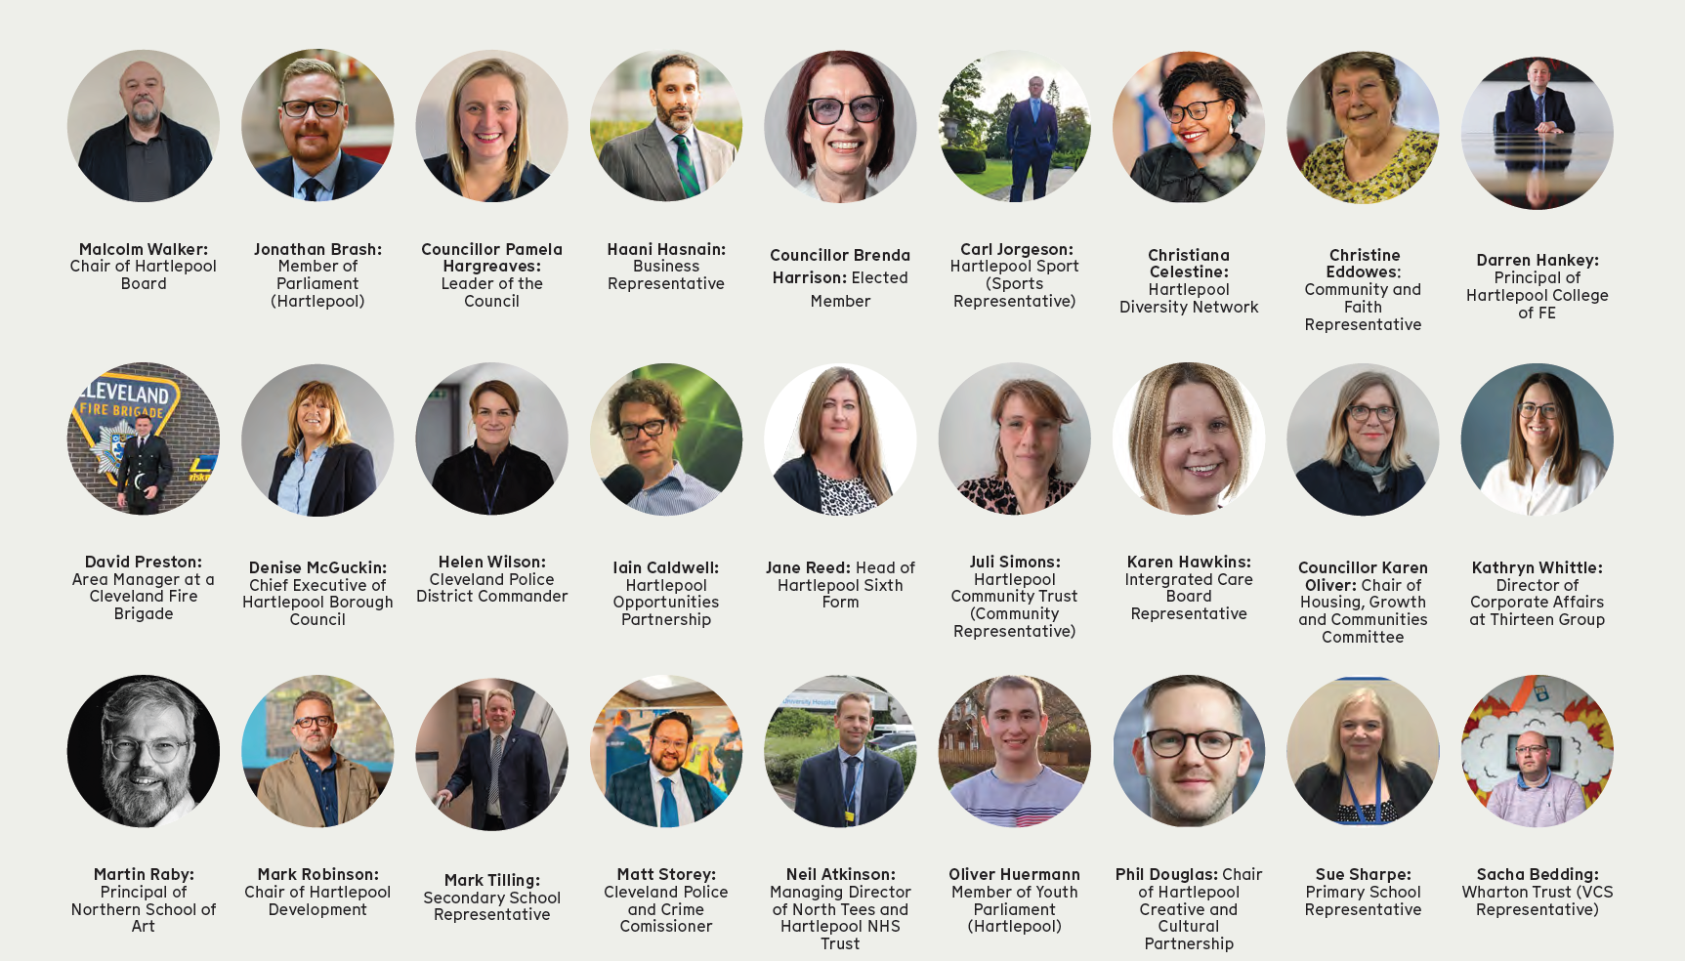
Hartlepool Board

Slide 7
Hartlepool Board
Networks
Networks
Rep
Rep
Rep
Rep
Rep
Rep
Young People
Business
Public Sector
Diversity
VCSE
Neighbourhood
Forums
Stakeholders
Neighbourhood
Forums
Quarterly
Network
Events
Regular
Community
Newsletters
Board
Roadshows
Bi-Monthly
Webinars

Slide 8

Updated Pride in Place Interventions
Safety & Security
Regen & High Streets
Education & Opportunity
- Tackle ASB and Crime
- Design Out Crime
- Policing Interventions
- Neighbourhood & Town Centre Improvements
- Enhance Green Spaces
- Arts & Creative Initiatives
- Reducing Child Poverty
- Community Learning
- Supporting Young People
Health & Wellbeing
Housing
Work & Productivity
- Community-Level Health
- Drug & Alcohol Support
- Co-Location of Services
- Sport & Physical Activity
- Neighbourhood Renewal
- Homelessness Support
- Energy Reduction & Efficiency for Homes
- Employment Support
- Business Support
- Developing & Promoting the Visitor Economy
Cohesion
Community Power
Transport
- Community Involvement - Wealth Building
- Community-Led Delivery
- Capacity Building
- Active Travel
- Improving Bus & Rail
- Improvements to the Road Network
- Measures to Improve Community Cohesion

Slide 9
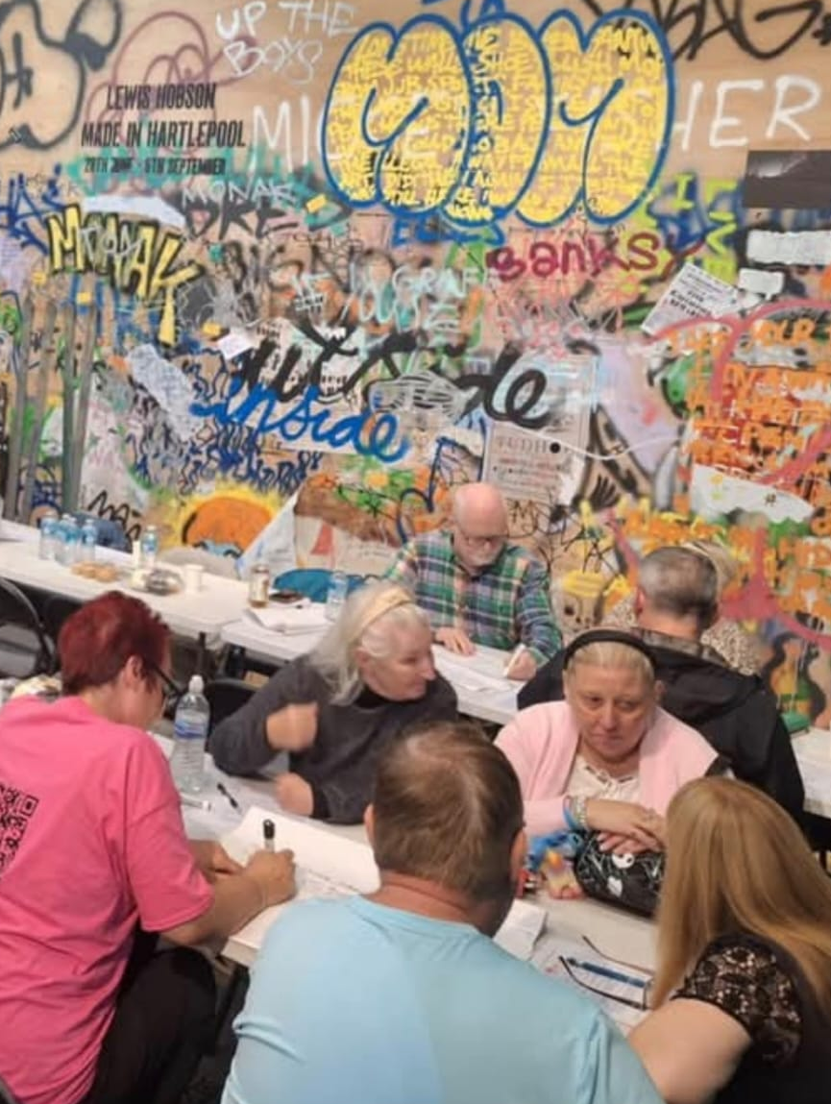
Community Engagement (1)
Led by Hartlepool Opportunities Partnership (HOP)
Aim was to gather local insight to find out the key priorities for people who live in Hartlepool
Team of Community Workers and Volunteers
10 weeks of engagement (July to September 2025)
Over 75 events across all 12 wards
Conversations with 1,441 residents of Hartlepool
At least 100 people engaged from each ward
Includes over 900 face to face conversations

Slide 10


Community Engagement (2)
1000
Priority Themes (by Votes)
Safety and Security (891)
Health and Wellbeing (627)
Cohesion (627)
High Street & Regeneration (610)
Transport (467)
Housing (325)
Work and Skills (266)
Education and Opportunities (70)
891 votes
800
600
627 votes
627 votes
610 votes
467 votes
400
325 votes
200
266 votes
70
0
Safety & Security
Health & Wellbeing
Cohesion
High Street & Regen
Education & Opportunity
Transport
Housing
Work & Skills

Slide 11


Community Priorities
Tackle Crime, Drugs and Anti-Social Behaviour
Clean Up the Town
Revive Community Spirit
Regenerate the Town Centre
Create Jobs and Opportunities
Transport and Infrastructure Upgrades
Better Health and Housing Services
Improve Parks and Seafront
Support Vulnerable Groups
Boost Local Pride and Tourism

Slide 12
Pride in Place Interventions
Safety & Security
Cohesion
Health & Wellbeing
- Tackling Crime, ASB and Reducing Reoffending
- Design Out Crime
- Policing Interventions
- Community-Level Health
- Drug and Alcohol Support
- Co-Location of Services
- Local Sport and Activity
- Measures to Improve Community Cohesion
High Street & Regen
Housing
Education & Opportunity
- Improvements to High Streets & Neighbourhoods
- Enhancing Green Spaces
- Arts & Cultural Initiatives
- Neighbourhood Renewal
- Homelessness Support
- Home Energy Efficiency & Lowering Bills
- Reducing Child and Family Poverty
- Support for Community Learning and Development
Community Power
- Engagement & Involvement
- Community Design & Delivery of Services
- Community Wealth Building
- Growing the Social Economy
- Volunteering, Social Action & Developing Social Capital
- Capacity Building

Slide 13
Priority Interventions
Safety and Security
1 | Design and oversight of the built and landscaped environment to ‘design out’ crime and encourage positive behaviour
2 | Policing interventions to target crime prevention in specific locations, in particular town centres
3 | Interventions to tackle anti-social behaviour, crime and minimise reoffending
Health & Wellbeing
1 | Supporting community-level health provision
2 | Provide drug and alcohol support for people with experience of homelessness and rough sleeping
3 | Integration and co-location of health and wellbeing services
4 | Funding for local sport and activity facilities, events, teams and leagues, to foster community engagement and connection

Slide 14
Priority Interventions
Community Cohesion
1 | Investment in capacity building and infrastructure support for local civil society, youth and community groups
2 | Measures to improve community cohesion
3 | Funding for impactful volunteering and social action projects to develop social and human capital in local place
High Streets, Heritage and Regeneration
1 | Funding for improvements to town centres, neighbourhoods, and high streets, including capital spend and running costs
2 | Creating and improving green spaces, community gardens, watercourses and embankments in the local area, along with incorporating natural features into wider public spaces
3 | Funding for local arts, cultural, heritage & creative initiatives

Slide 15
Priority Interventions
Housing – Foundational
1 | Support wider neighbourhood renewal by improving the attractiveness and liveability of homes and their surroundings
2 | Provide safe and supportive environments for people with experience of homelessness and rough sleeping
3 | Support local community initiatives that support people in bringing down their home energy bills and improve the energy efficiency of their homes
Education & Opportunity – Foundational
1 | Support to both reduce levels of child poverty and to prevent the negative impacts of child poverty on children and families
2 | Support for growing the local social economy, including community businesses, cooperatives and social enterprises
3 | Support for community-based learning and development

Slide 16
Pride in Place Investment Development
These creative workshops are designed to generate projects/ideas and understand best practice against our identified challenges and to develop potential approaches for PiP
Innovation Days
This will allow potential local suppliers to be engaged such as via ‘Meet the Buyer’ events as part of the development of capital projects
Industry Engagement
Safety & Security
Cohesion
Housing
Health & Wellbeing
Regen & High Streets
Education & Opportunity
Themed Investment
Decision-Making Subgroups
The subgroups will translate all the ideas into actionable investment projects for Hartlepool
Prioritising Investment
Ideas into Projects
This will agree finalised proposals, identify the delivery method(s) and make recommendations to the Hartlepool Board
Proposals

Slide 17
Innovation Days
Monday 9 March 2026 – 1pm to 4pm
West Hartlepool Rugby Club
Theme: Regeneration, High Streets and Heritage
Wednesday 11 March 2026 – 9am to 12noon
Belle Vue Community Centre
Theme: Health and Wellbeing
Friday 20 March 2026 – 9am to 12noon
Belle Vue Community Centre
Theme: Safety, Security and Cohesion

Slide 18
Thank you
gemma.ptak@hartlepool.gov.uk
scott.campbell@hartlepool.gov.uk

